Slide 1


DECEMBER 13, 2025
AI-POWERED INTELLIGENT STUDENT SUPPORT SYSTEM
Team Lead - Swetha Battula
Implementation Planner - E Pravalika
Business Analyst - M Sai Kala
Implementation Planner - P Pavan
Business Analyst - A Yamini
Presenter - P Naga Sumanth
Solution Designer - V Swathi
Presenter - P Naga Abhinay

Slide 2
PROBLEM ANALYSIS
-DEFINE PHASE
  Delayed response times:
Student questions take 48–72 hours to get answered.
  High Support Costs:
The university depends heavily on manual support staff, which increases costs and workload.
  Student Dissatisfaction:
Recent surveys show only 62% satisfaction with support services
  Scattered student information:
Student data is stored in many different old systems, making it hard to coordinate between departments
  Inefficient Resource Allocation:
Support staff spend 60% of their time answering repetitive questions

Slide 3
SOLUTION OVERVIEW
-DESIGN PHASE
  AI-Based Student Support Bot
First point of contact providing 24/7 support and answering student queries.
  Unified Student Data Access
Using ESB technology for integrating student data from legacy systems, without replacing existing systems.
  Status Tracking
Automatic case generation and status tracking for student queries and forwarding to support staff.
  Secure & Compliant Design
Built-in security with Role-Based Access Control (RBAC) to protect student data.

Slide 4
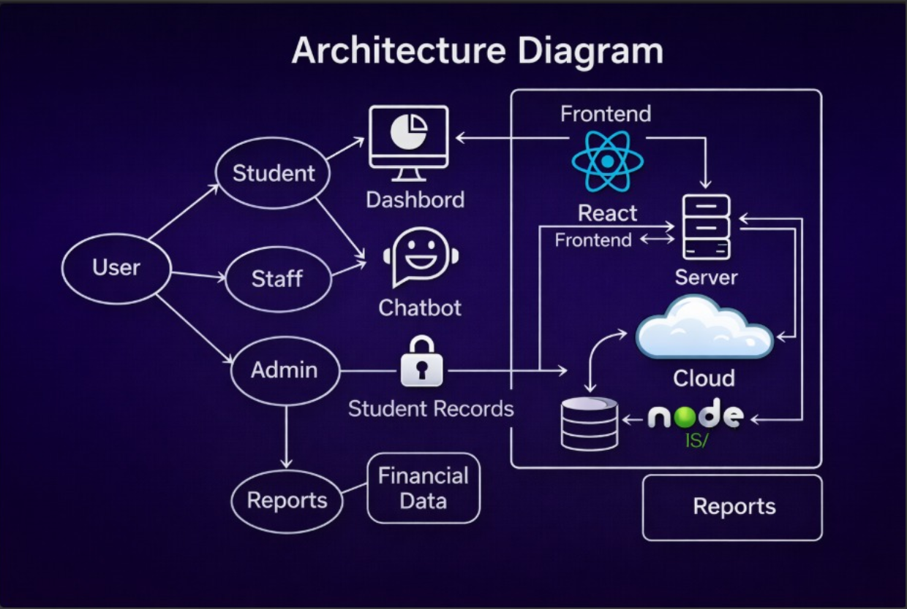
ARCHITECTURE
-DESIGN PHASE

Slide 5
SPRINT PLAN
-DEVELOP PHASE
01
Project vision Goals :
automation tasks
Surveys , Assignments
Integrations -> systems
Advanced Features -> Emergency tasks
05
02
Designing Infrastructure and Planning
Set up Development Platforms
06
Implementing other stages of development -> 24/7 support
AI prototyping:
Building layer / middleware to integrate ai with the legacy systems
03
07
Testing with different users and groups Feedbacks
08
Refinement and iterate
Deploy, Maintain, and Monitor
04
Testing, Implementing mechanisms to track AI working behaviour

Slide 6


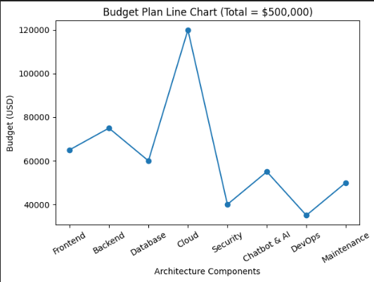
BUDGET PLAN
-DEVELOP PHASE

Slide 7
KPI & OUTCOMES
KPI & OUTCOMES:
  Response Time: 80% of queries answered under 5 minutes.
  Automation Rate: 70% queries handled by AI bot.
  Student Satisfaction: Improve from 62% → 85%.
  Staff Workload: Reduce by 50%.
  Operational Cost Reduction: Annual cost savings post-deployment.
  24/7 Support Availability without human dependency.

Slide 8
Presented By : Team-B
THANK YOU

